Slide 1
New Technology for the 2025 Solar Car Challenge
Eric Andrechek, Race Technology Director and
Brandon Ching, Technology Board and Solar Car Challenge Foundation Board Member

Slide 2
Background
Eric Andrechek
Okemos Solar 2019-2021
University of Michigan - CS, EE, Entrepreneurship
Founder Wave RF
Brandon Ching
Coppell Solar 2016-2020, Team President 2019, 2020
Colorado School of Mines - ME, CS
Interned at and works for Lockheed Martin

Slide 3
Brief History of Solar Car Scoring
Recording Scores:
Multiple judges who each tally the car number every time it crosses
At the end of the day, they are counted and audited for final totals
Scoring Technicalities:
Laps are marked when a car crosses the start/stop line OR exits the track on its own power
Laps are marked with time stamps and during auditing we evaluate if things like rest periods and exiting on the last lap were done in time

Slide 4
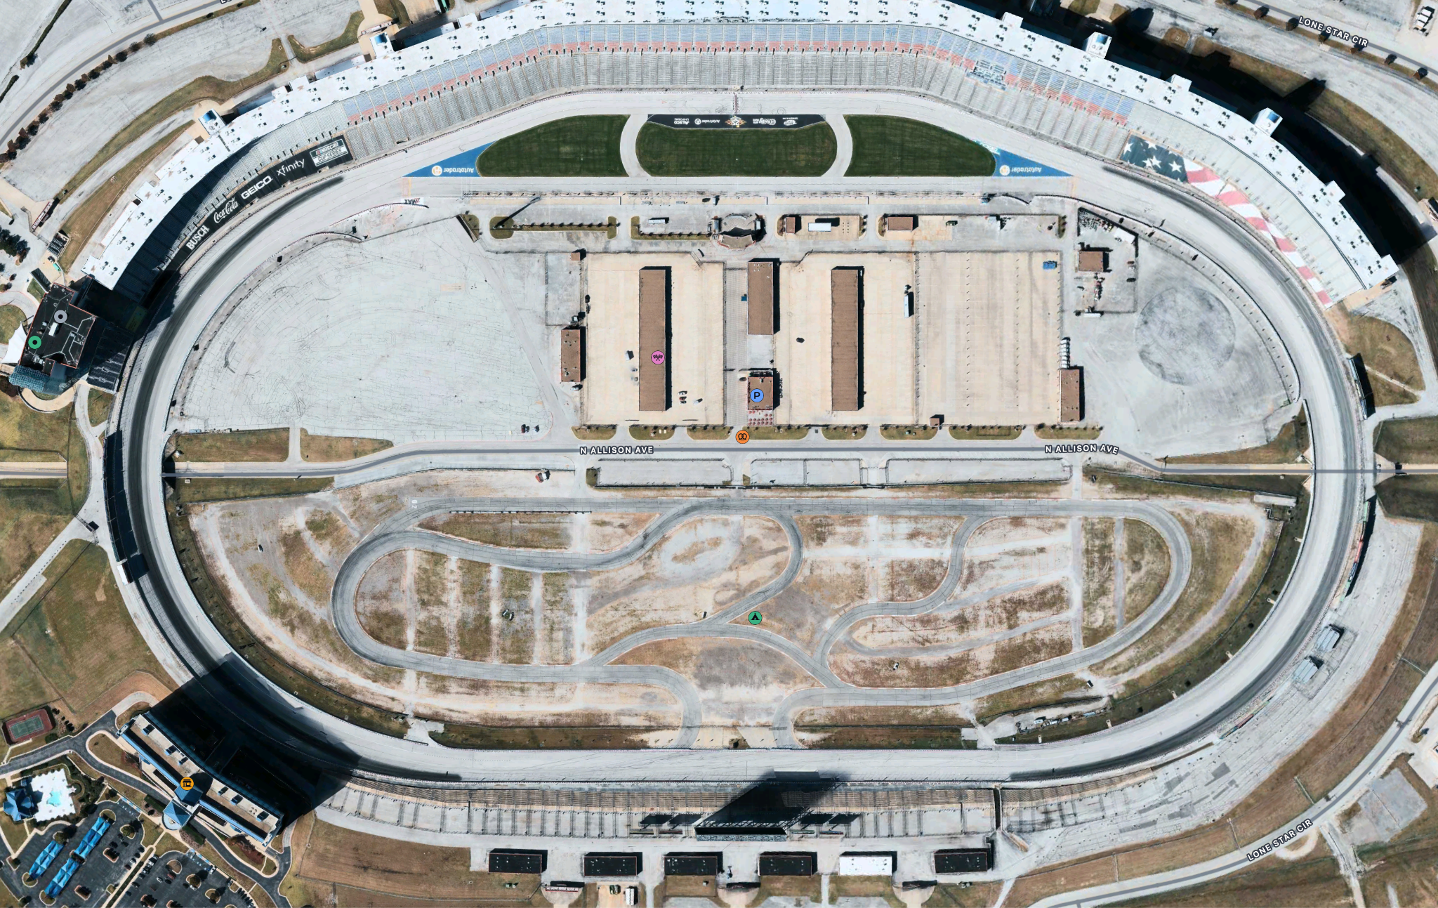

Slide 5
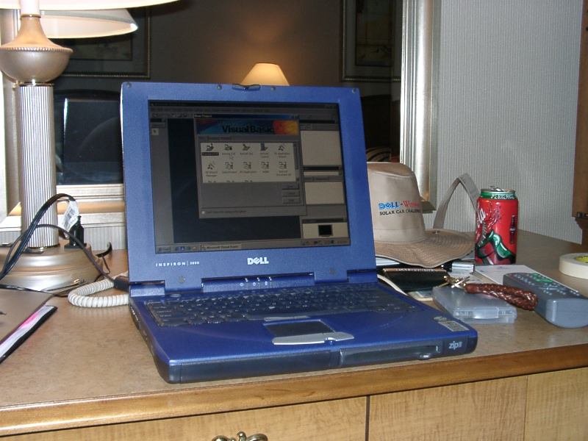
Early History of Solar Car Scoring
Originally, this was all done on legal pads by judges
Until:
The advent of the computer in the Solar Car Challenge,
circa 2002 (colorized)

Slide 6
Introducing: Clickey
Revolutionized the scoring process with ✨automation✨
Judges could click the team # of the car passing the start/stop line
Lowered error rates compared to pen/paper
Allowed running programs to aid in auditing daily results for official

Slide 7
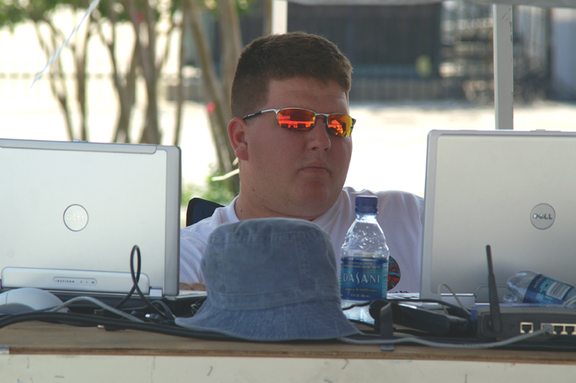
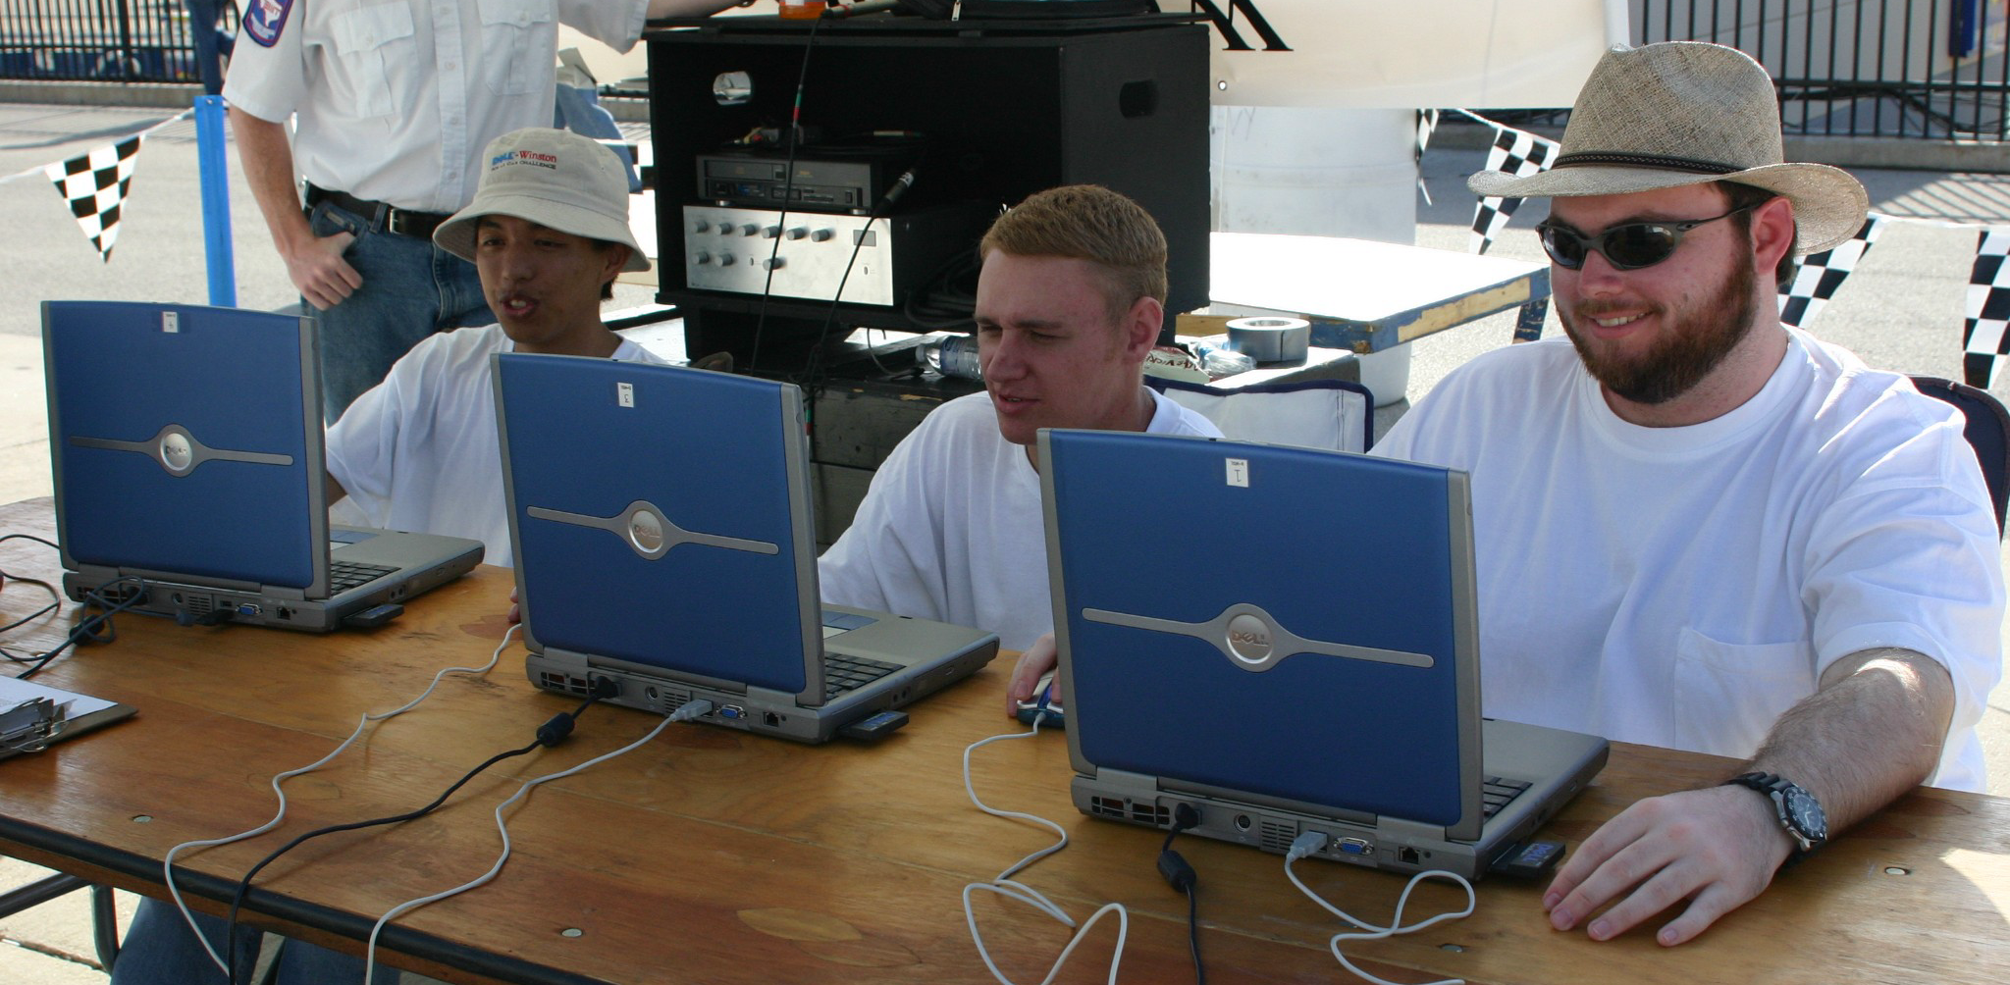
Introducing: Clickey
Clickey had problems:
Windows XP → 7 requirements
EXE file to distribute to each PC to run
Each computer directly edited the scoring server (bad!)

Slide 8
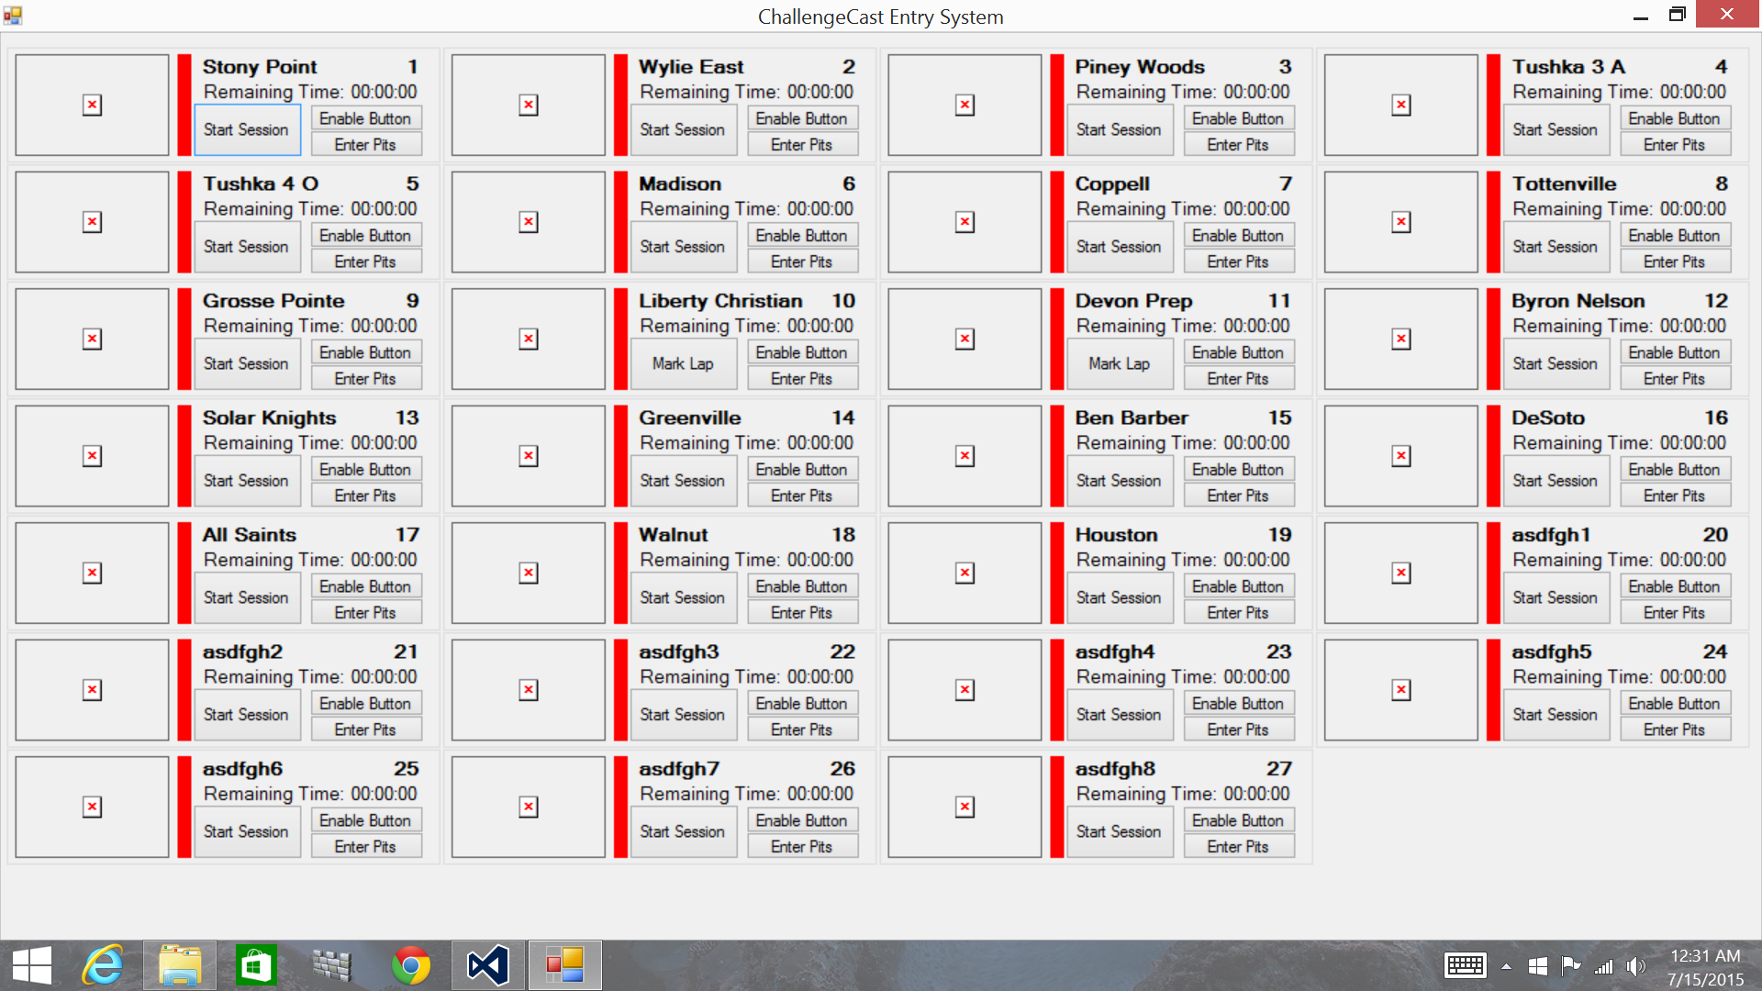
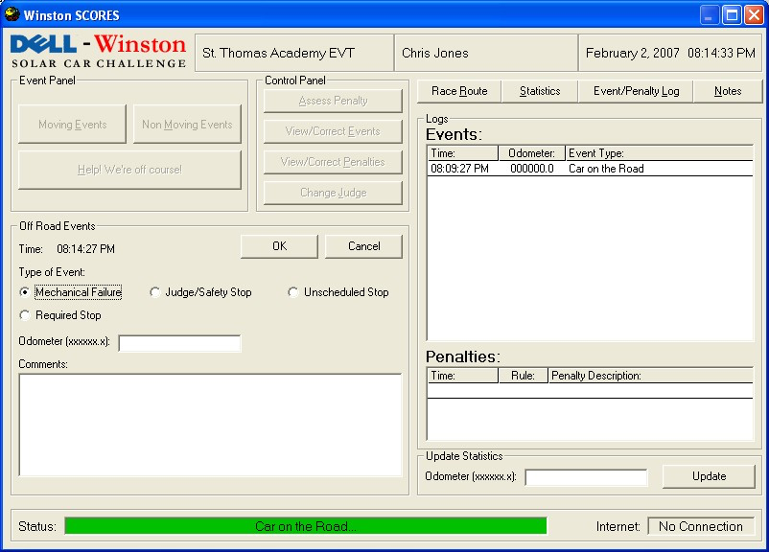
Clickey 1.0

Slide 9
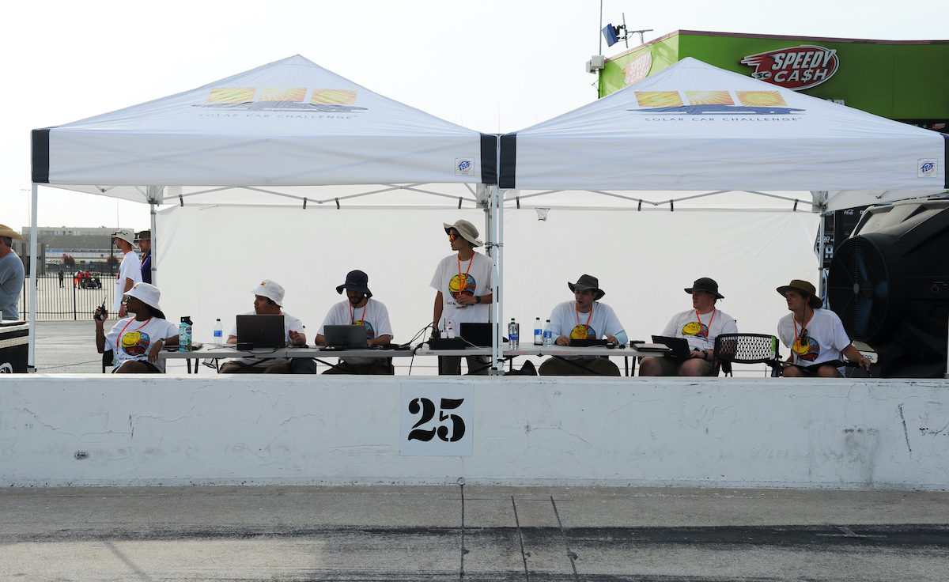
Modern Era: Clickey 2.0
Able to run on laptops, iPads, phones, etc through web browser
Caches results locally to work offline and push later
Undo for misclicks no longer literally deleted database records, which could have resulted in lost data

Slide 10
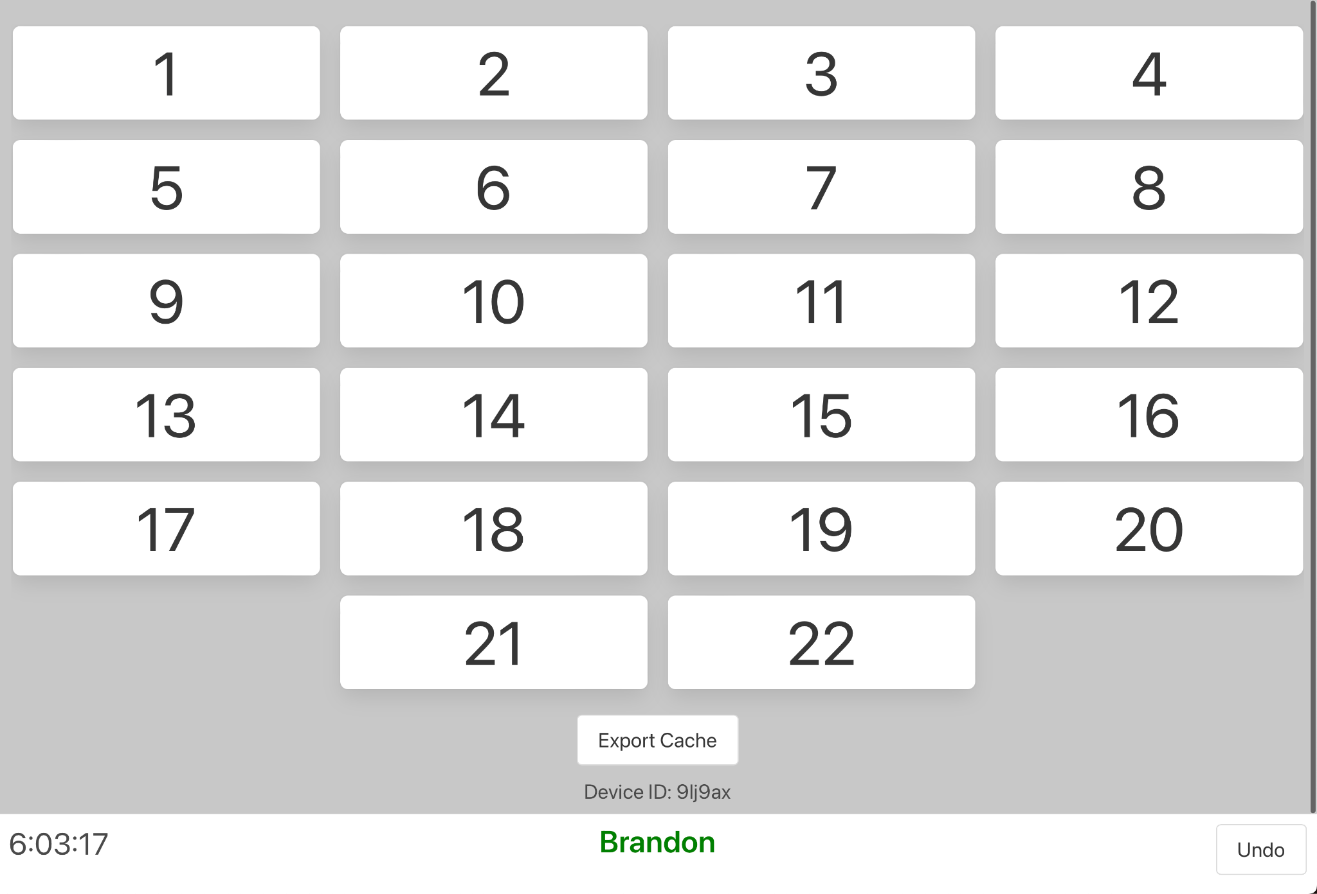
Can you tell where this software gets the name “Clickey” from?

Slide 11
Clickey 2.0: Results
Michael Foree, Solar Car Challenge Board Member
2008 w/ Old Clickey
2022 w/ New Clickey

Slide 12
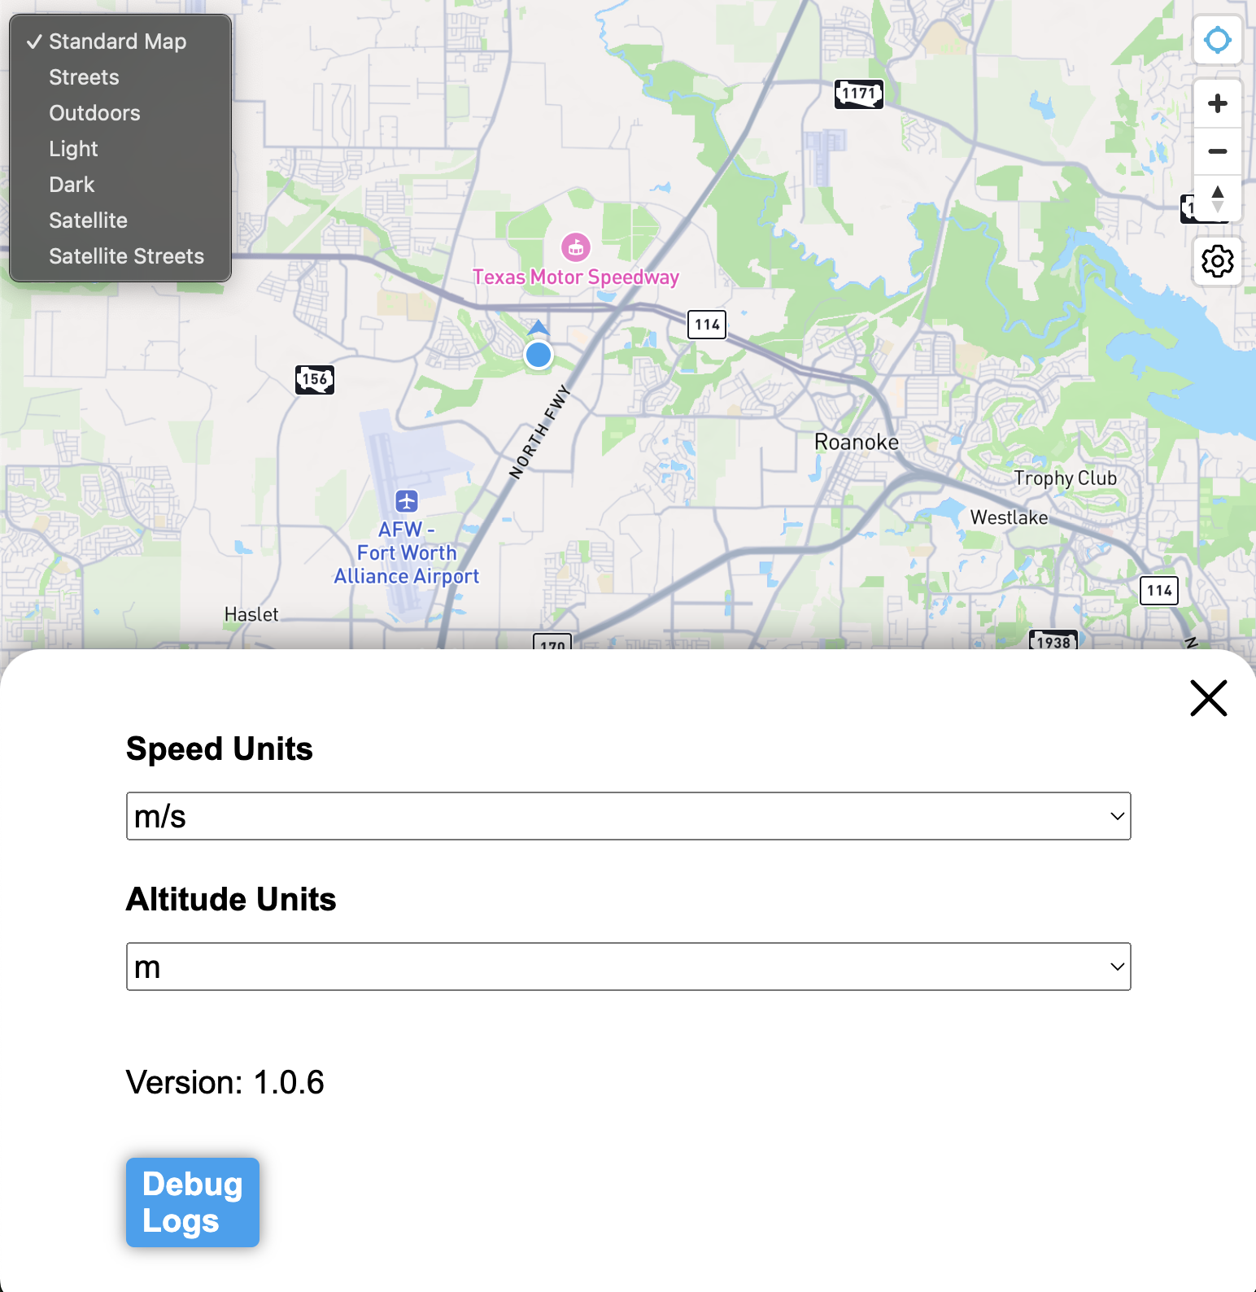
The Future
Live lap times for every team
Live (unofficial/unaudited) daily race results
Average lap speeds (mph) ← we’ll know if you go below 20mph!
Live maps!
Beta tested idea last summer
More wide-spread testing this summer and next to confirm results match current systems

Slide 13
More Innovations?
We need your help!
We like our software too much and need new talent to make fun of our now antiquated ways like we did when we joined
As we automate more, we need more help building and maintaining our growing codebase (CS people, looking at you here!)
We want your ideas as racers for what things you want to see or wish existed, like teams having the ability to edit their own race registration pages

Slide 14
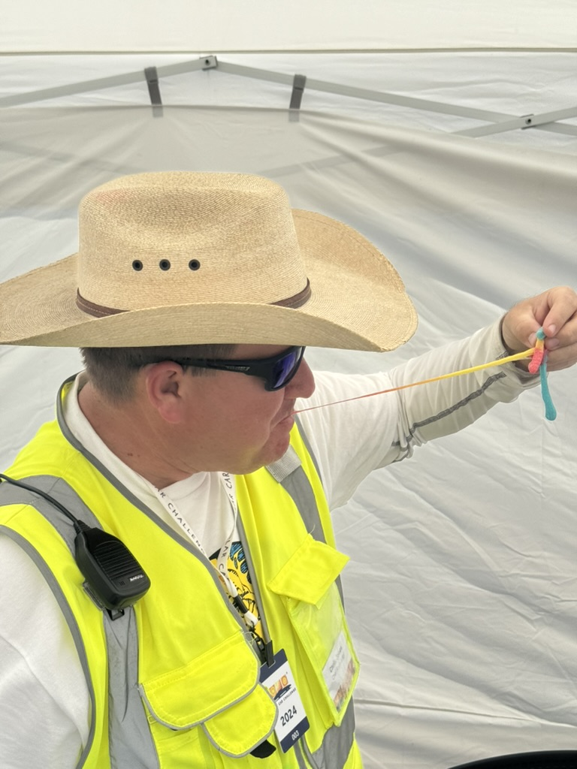
Why you should be an intern!
Stay connected to solar challenge, as well as an opportunity to give back to the race that impacted your life so much
Learn what it takes to put a race of this caliber on
Have a great summer internship experience for your resume!
Make new connections/network for future jobs!
Meet lots of fun people!

Slide 15
Questions, Comments, and Concerns
Direct positive comments and fun ideas to:
Eric Andrechek (eric@solarcarchallenge.org)
Complaints and concerns to:
Brandon Ching (brandon@solarcarchallenge.org)
We hope this presentation has showed you that we have fun working here :)
Thank you!

